Slide 1

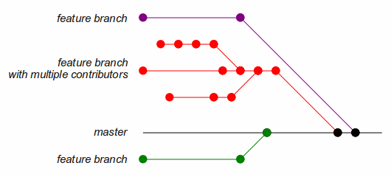
Family Tree
A git project by Stars

Slide 2

Basic Idea
The most important aspect of the project was to use the git commands and related packages like git graph.
The aim of this project was to explore and utilize git features such as branching and merging.
We thought let's make a project (using shell script) which uses only git commands. Then thought of making a family tree came.
A family tree is utilizing all the functionalities we needed.

Slide 3
Challenges
The first challenge was to get rid of unwanted git add command as there was no use of it.
The second one was to keep track of Head and master branch as we are first using the master branch to create a commit.
To find the git commands that does the job we required.

Slide 4
Implementation
We used Shell programming to do the job as it is the common language we use and it is easy to implement git commands using shell script.
Git command :- git commit --allow-empty –m "comment" came to our help. It sorted our problem of adding unwanted files when committing.
Another useful thing was git tag command.

Slide 5
How To Use
The program is made very simple with easy instructions to follow.

Slide 6

Steps
Just run the shell program and give the input it asks. It will ask you to give the name of the head of the family at first.
Then it will give you five options. Just write the serial number of the option you want to use .
At last if you want to exit and generate git graph of family tree use exit option.

Slide 7
Biblography
Image Credits :-
1. theverge.com
2. softwarerecs.stackexchange.com
3. medium.com

Slide 8

Thank You
Team Members :- Santaz Sahithi
Aayush Deshmukh
Shubham Gupta

